Slide 2
Inductive Bible
Study Method

Slide 3
Welcome back to IBSM
Bite 06

Slide 4

Ten Strategies for First-rate Reading

Slide 5
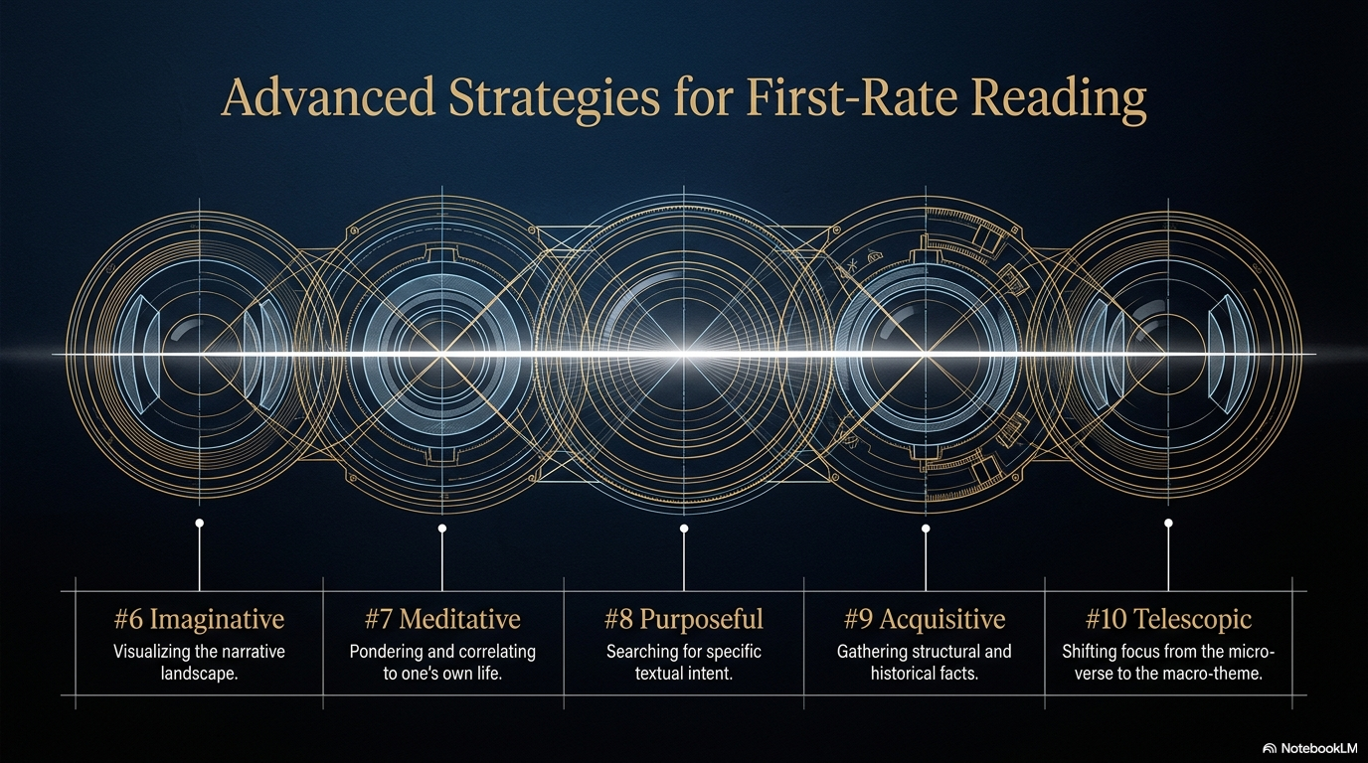

Slide 6
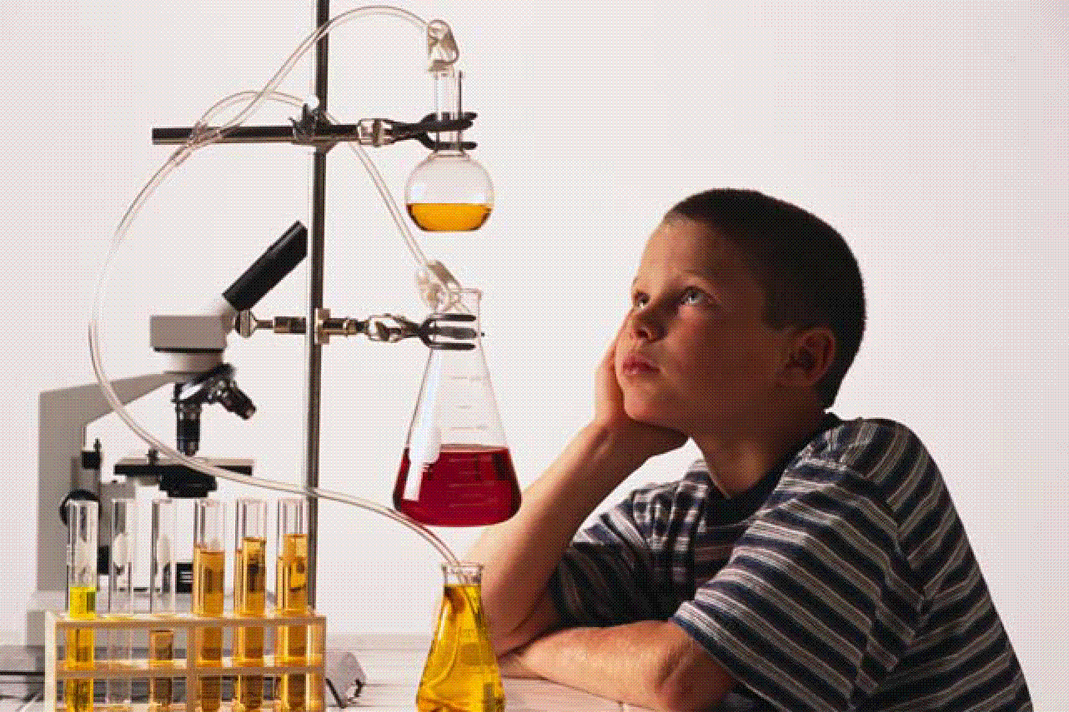
#6 Read imaginatively

Slide 7
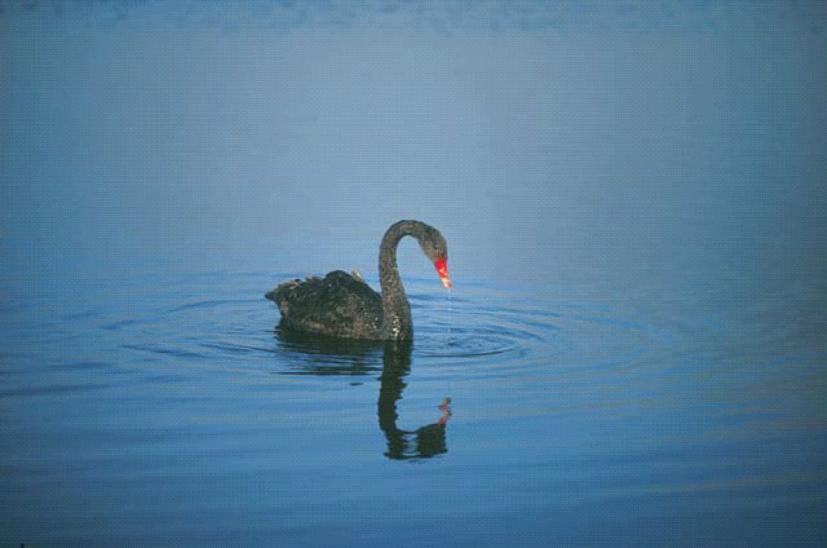
#7 Read meditatively

Slide 8
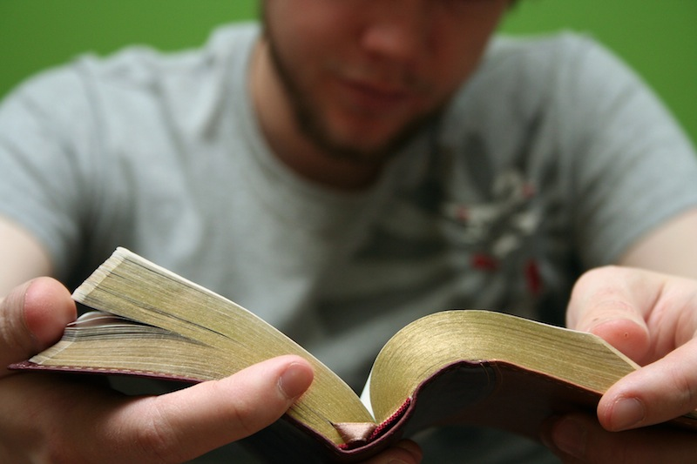
7. Read Meditatively
What does it mean to meditate?
“Act of calling to mind some supposition, pondering upon it, and correlating it to one’s own life.”
Reference: LeBron Matthews, Meditation, ed. Chad Brand et al., Holman Illustrated Bible Dictionary (Nashville, TN: Holman Bible Publishers, 2003), 1096.

Slide 9
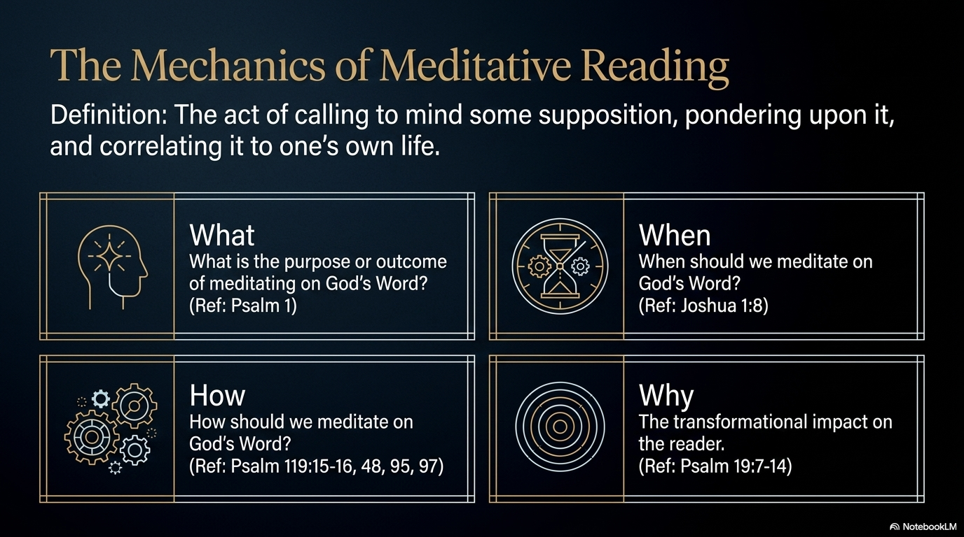

Slide 10
7. Read Meditatively
Exercise:
Read the following verses carefully, then answer the questions below. Be sure to cite Bible verses as support for each of your responses.
Joshua 1:8
Psalm 1
Psalm 19:7-14
Psalm 119:15-16, 48, 95, 97
What is the purpose or outcome of meditating on God’s Word?
When should we meditate on God’s Word?
How should we meditate on God’s Word?

Slide 11
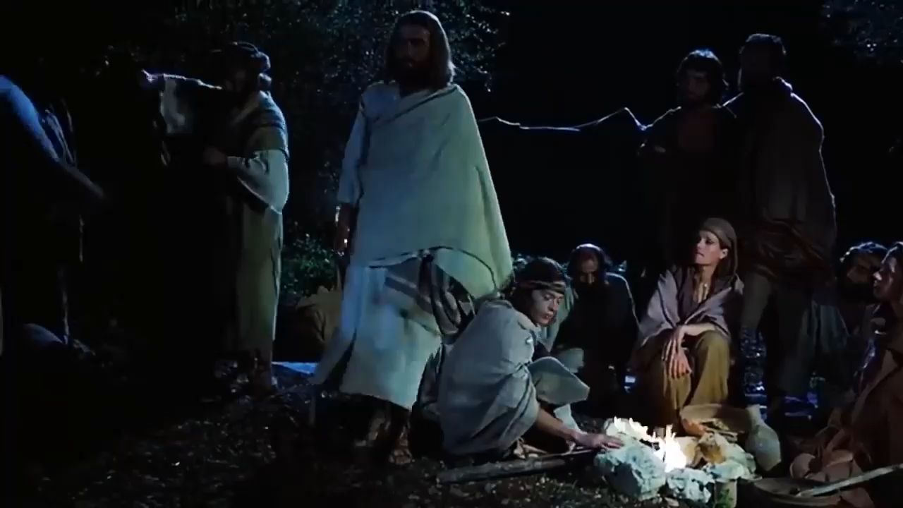

Slide 12


Slide 13

#8 Read purposefully

Slide 14
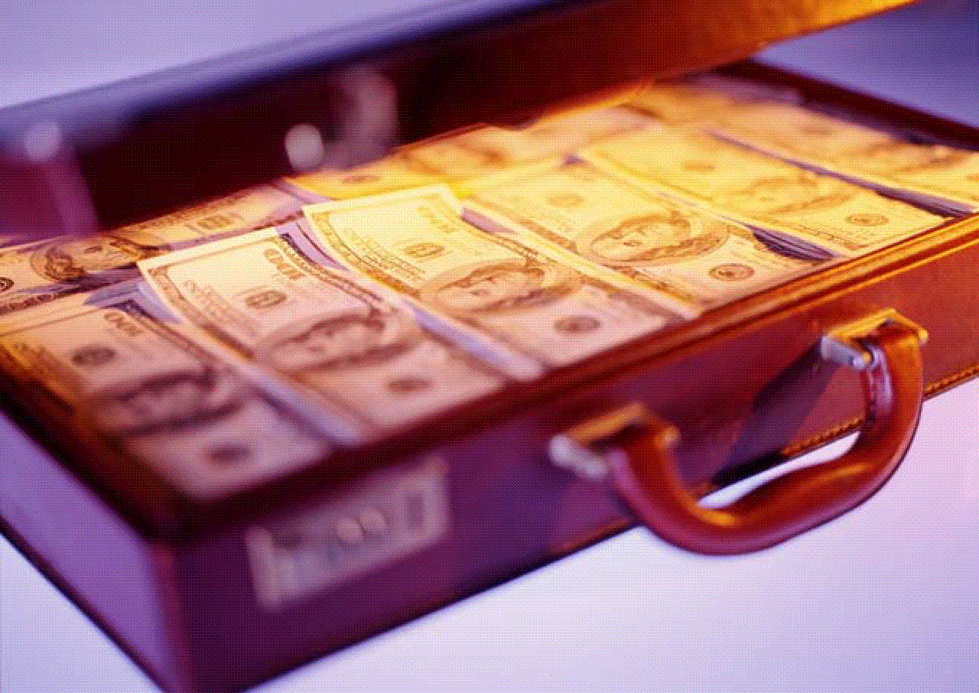
#9 Read acquisitively

Slide 15
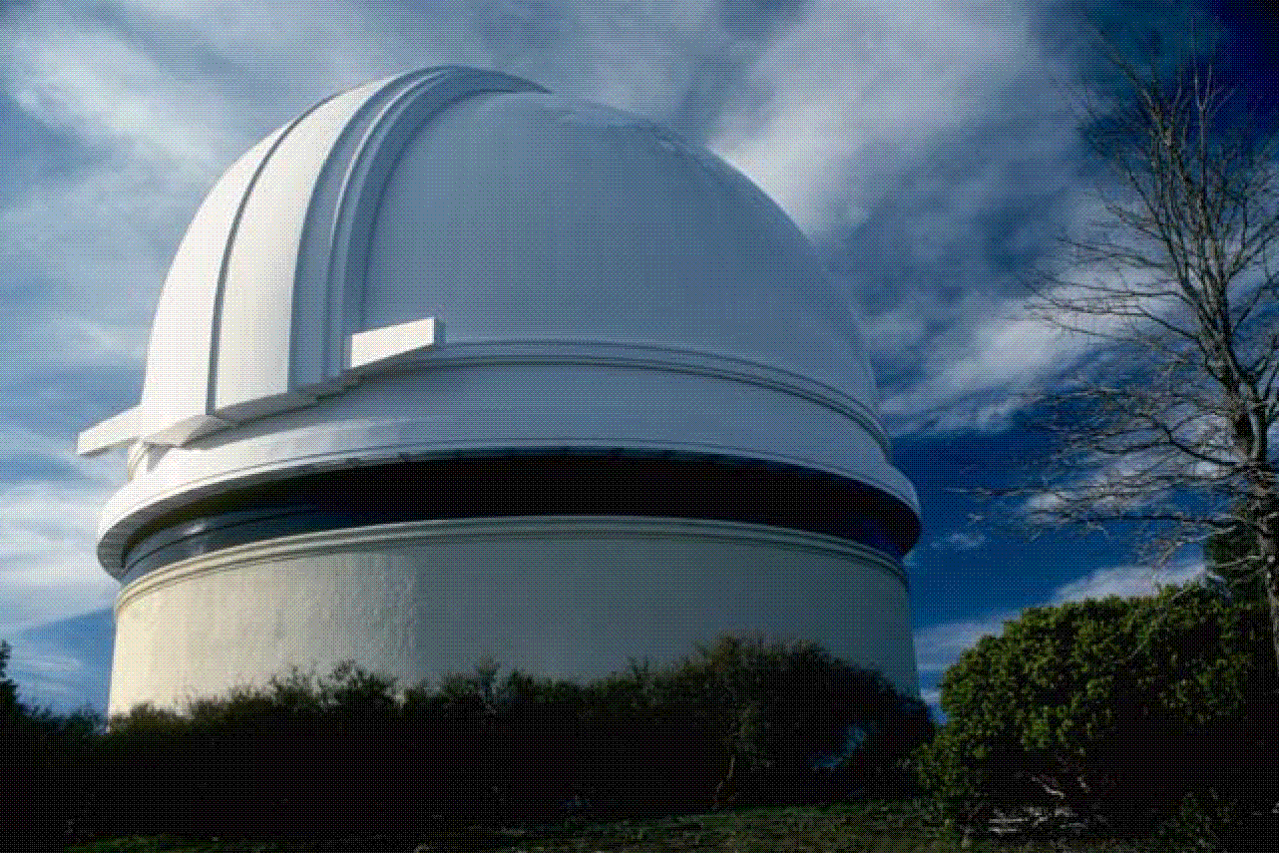
#10 Read telescopically

Slide 16
The Kingdom of God:
Bible’s All-Encompassing Theme
Genesis 1:26-28
“Then God said, ‘Let us make man in our image, in our likeness, and let them rule over the fish … birds … livestock … all the earth, and over all the creatures that move along the ground…’ God blessed them and said to them, ‘Be fruitful and increase in number; fill the earth and subdue it. Rule over the fish of the sea and the birds of the air and over every living creature that moves on the ground.’’’
Revelation 22:5
“There will be no more night. They will not need the light of a lamp or the light of the sun, for the Lord God will give them light. And they will reign for ever and ever.”

Slide 17
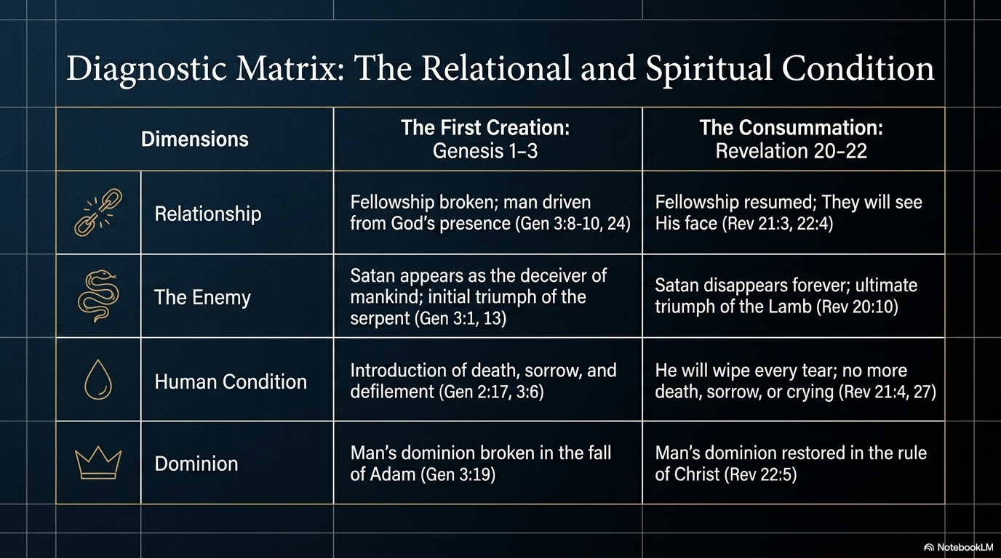

Slide 18
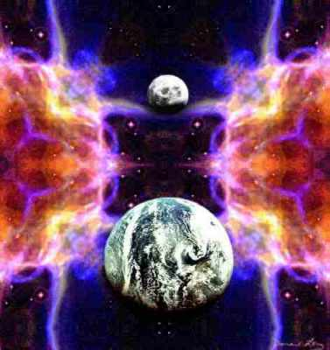
The New Heaven & New Earth

Slide 19
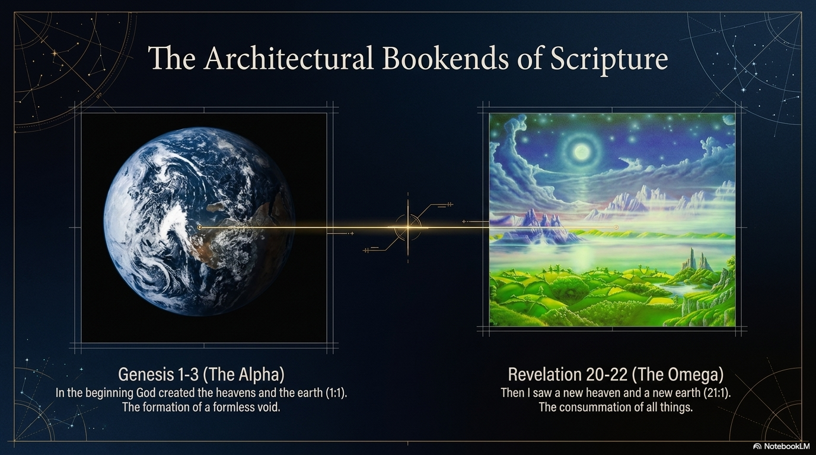

Slide 20
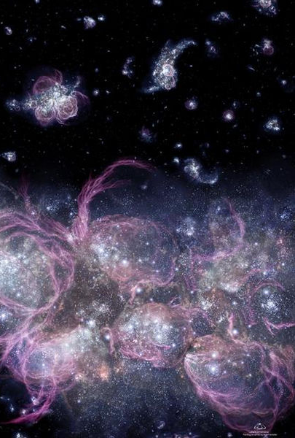
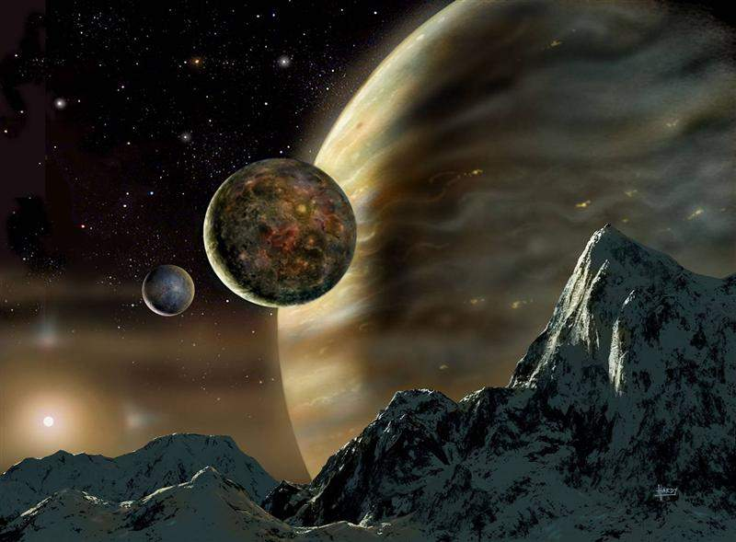
The Consummation of All Things
Genesis 1–3
Revelation 20–22
“In the beginning God created the heavens and the earth” (1:1)
“Then I saw a new heaven and a new earth” (21:1)
Notes:
The first three chapters of Scripture have many parallels in the last three chapters.

Slide 21
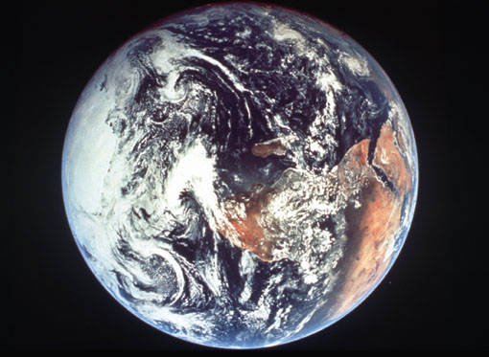
Days of Creation
Void
Formless
Forming
Filling
Day 4: Sun, moon & stars arranged
Day 1: Light
Day 2: Water & air separated
Day 5: Fish & fowl
Day 3: Land & sea separated
Day 6: Animals & man
Genesis 1:3-31

Slide 22
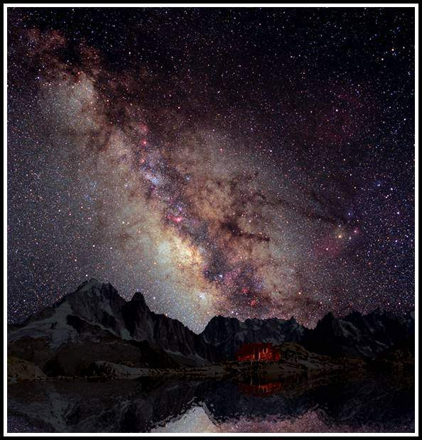
Summary
God’s Creation…Day 7
Thus the heavens and the earth were completed,
and all their hosts. (2:1)

Slide 23
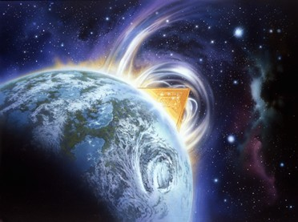
Then I saw a new heaven and a new earth, for the old heaven and the old earth had disappeared. (21:1a NLT)

Slide 24
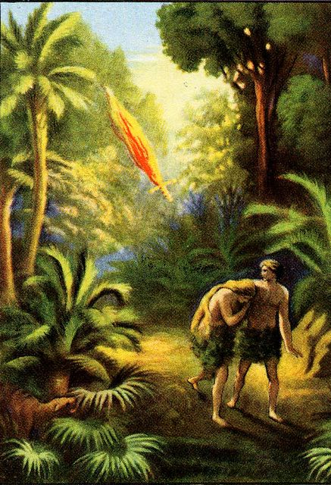
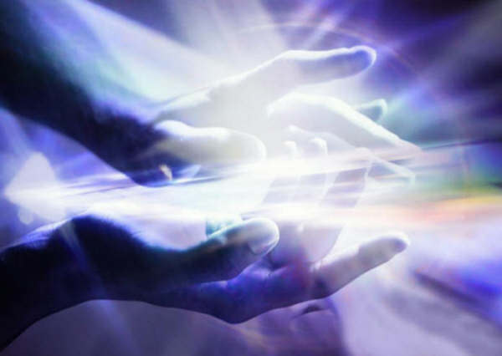
The Consummation of All Things
Genesis 1–3
Revelation 20–22
Fellowship with God broken
(3:8-10)
Fellowship with God resumed
(21:3)

Slide 25
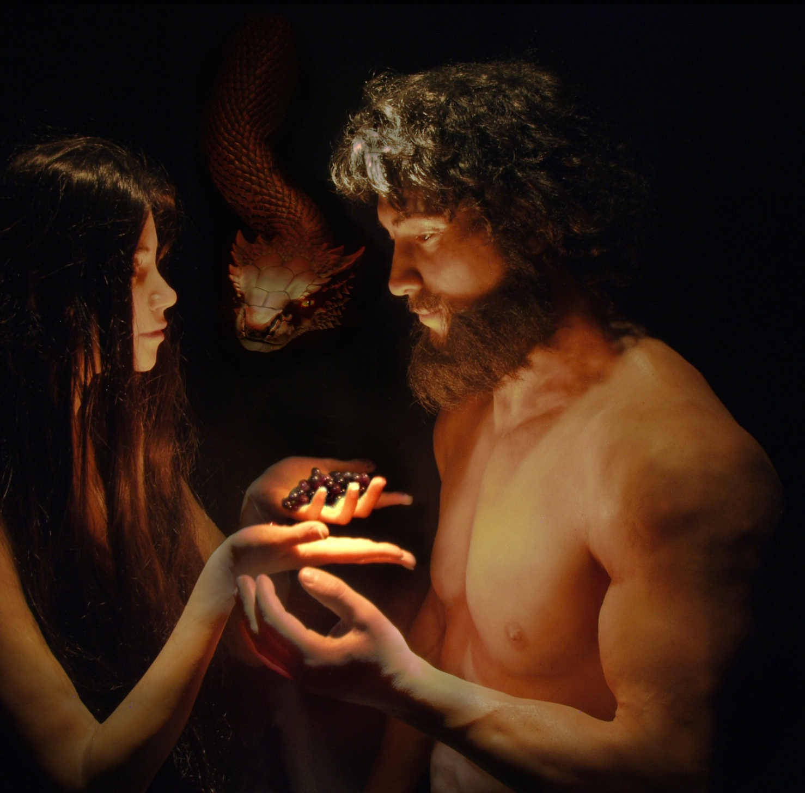

The Consummation of All Things
Genesis 1–3
Revelation 20–22
“In the day you eat of it you will surely die.” (2:17)
“There will be no more death”
(21:4)
“I will greatly multiply your sorrow.” (3:16)
“There will be no more... sorrow or crying or pain” (21:4)

Slide 26
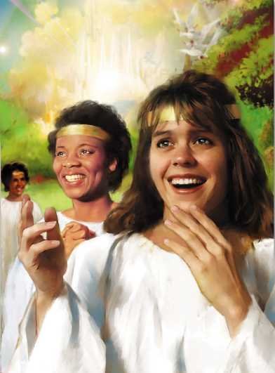
He will wipe every tear from their eyes, and there will be no more death or sorrow or crying or pain. All these things are gone forever.
(21:4 NLT)
340

Slide 27
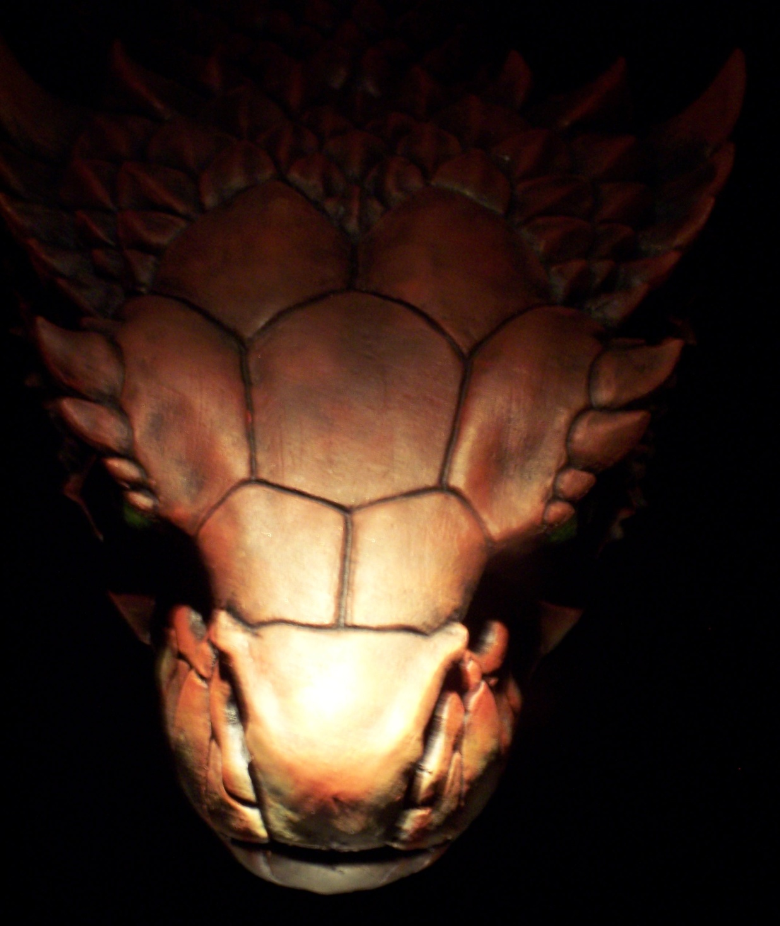
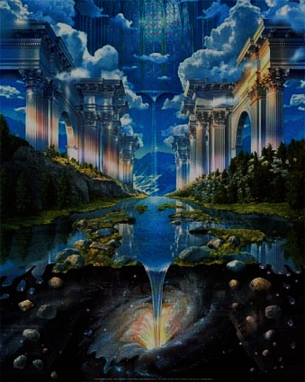
The Consummation of All Things
Genesis 1–3
Revelation 20–22
Satan appears
as deceiver of mankind (3:1)
Satan disappears forever (20:10)
Initial triumph
of the serpent (3:13)
Ultimate triumph
of the Lamb
(20:10; 22:3)
Defilement enters the garden (3:6-7)
Defilement never enters the city (21:27)

Slide 28
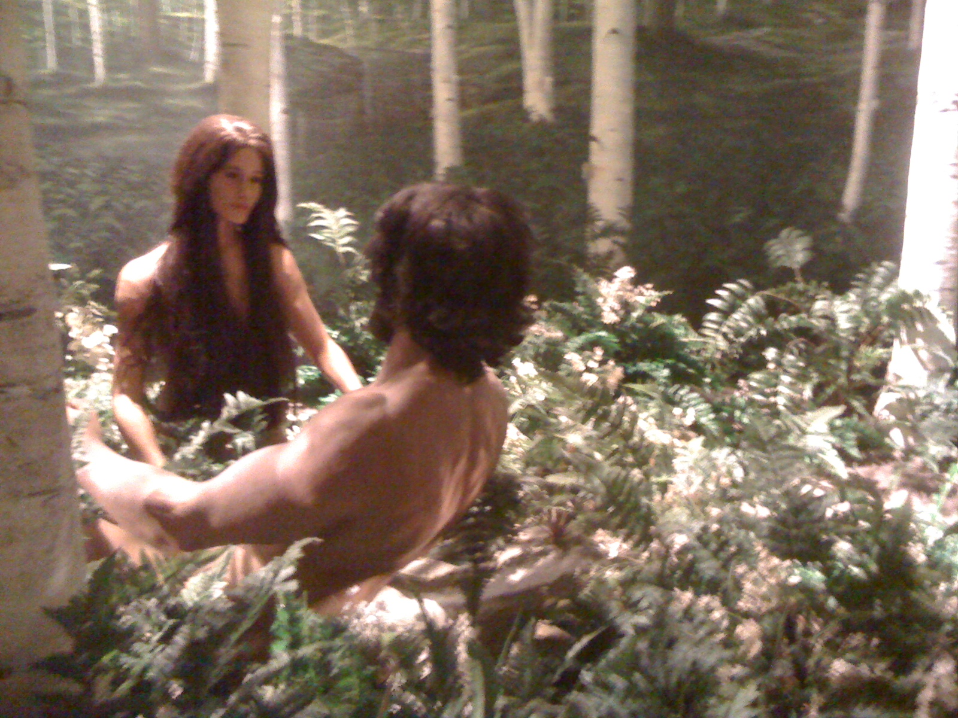
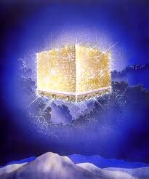
The Consummation of All Things
Genesis 1–3
Revelation 20–22
Husband and wife (2:18-25)
Lamb and bride (19:6-9; 21:9-10)

Slide 29
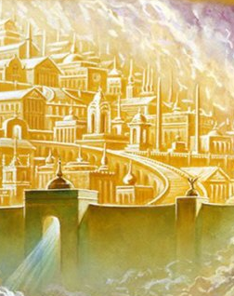
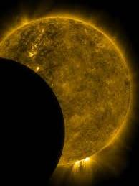
The Consummation of All Things
Genesis 1–3
Revelation 20–22
God made two great lights (sun and moon; 1:16)
“The city does not need the sun or the moon” (21:23)

Slide 30
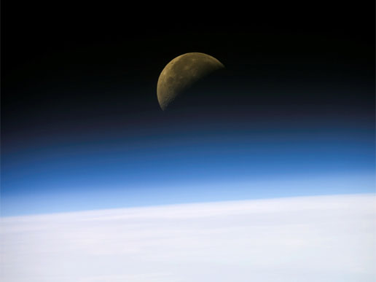
And the city has no need of sun or moon, for the glory of God illuminates the city, and the Lamb is its light.
(21:23 NLT)

Slide 31
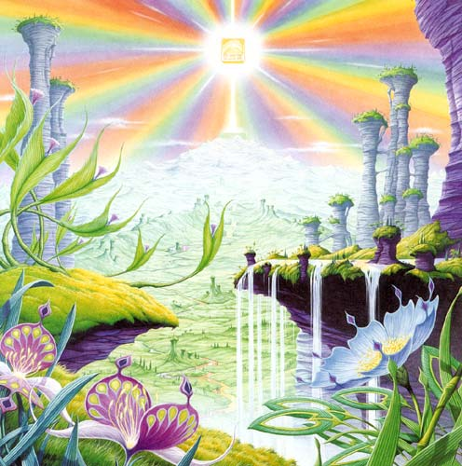
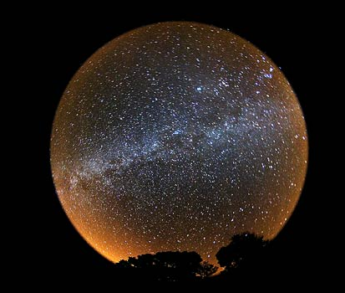
The Consummation of All Things
Genesis 1–3
Revelation 20–22
The darkness He called
night (1:5)
“There will be
no night there”
(21:25; 22:5)

Slide 32
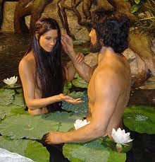
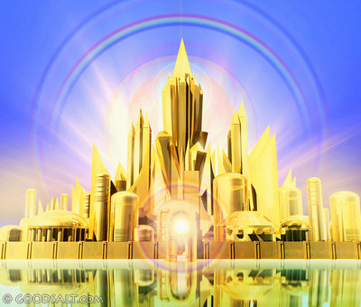
The Consummation of All Things
Genesis 1–3
Revelation 20–22
First paradise closed (3:23)
New paradise opened (21:25)

Slide 33
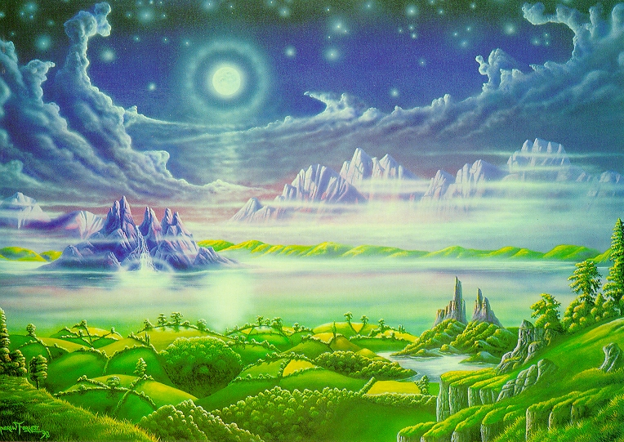
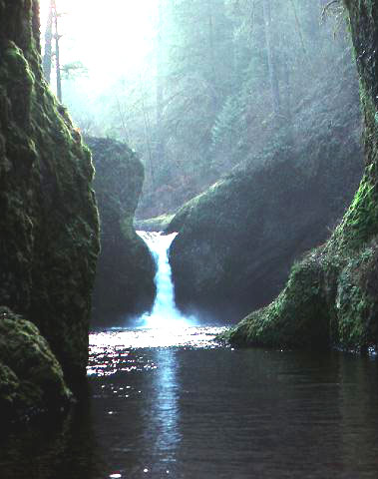
The Consummation of All Things
Genesis 1–3
Revelation 20–22
Trees and rivers (2:8-14)
Tree and river
(22:1-2)

Slide 34
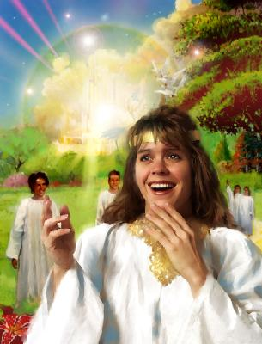
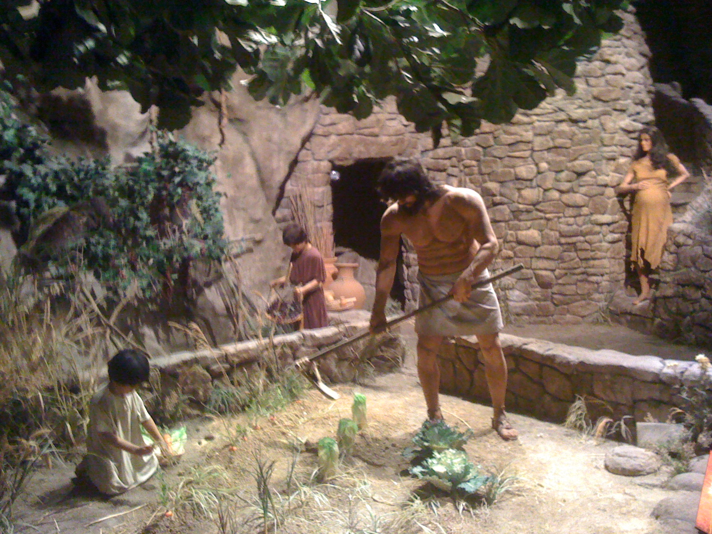
The Consummation of All Things
Genesis 1–3
Revelation 20–22
“Cursed is the ground because of you” (3:17)
“No longer will there be any curse” (22:3)

Slide 35
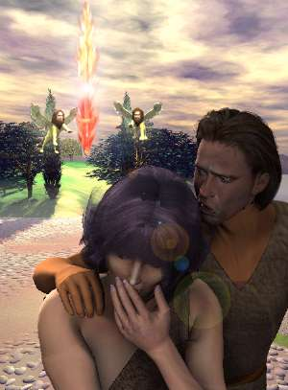
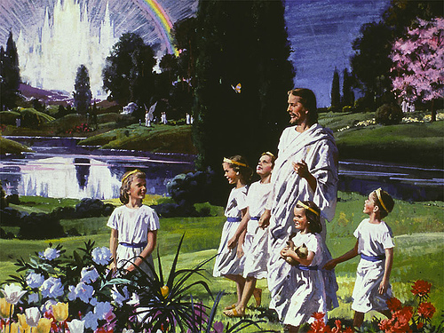
The Consummation of All Things
Genesis 1–3
Revelation 20–22
“They will see His face” (22:4)
Man driven from God’s presence (3:24)

Slide 36
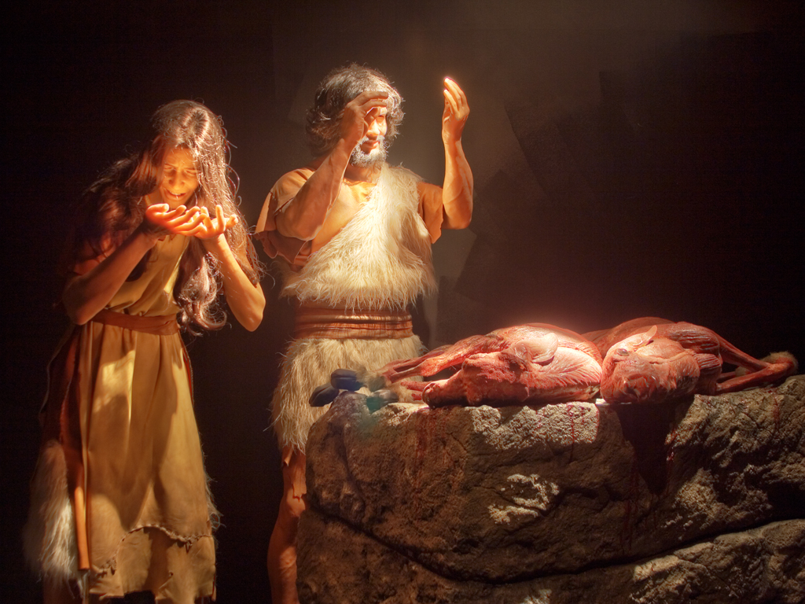
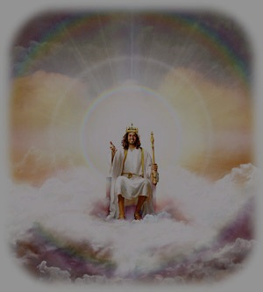
The Consummation of All Things
Genesis 1–3
Revelation 20–22
Man’s dominion broken in the fall of the first man, Adam (3:19)
Man’s dominion restored in the rule of the new man, Christ (22:5)

Slide 37
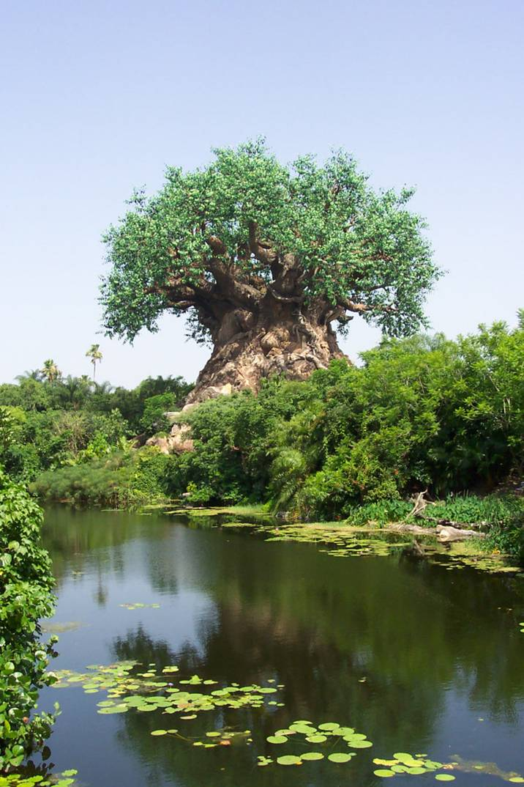
The Consummation of All Things
Genesis 1–3
Revelation 20–22
Prohibition from the tree of life (3:24)
Access to the
tree of life (22:14)

Slide 38
The hearing ear and the seeing eye,
The Lord has made both of them.

Slide 41
THE BIBLE’S STORY
CREATION
FALL
REDEMPTION
NEW
CREATION
Four
Events
Four
Peoples
Five
Kingdoms
Four
Hundred
GENESIS 1–2
GENESIS 3
REDEMPTION FORESHADOWED:
LAW & HISTORY, POETS & PROPHETS
REDEMPTION
ACCOMPLISHED:
GOSPELS
REDEMPTION APPLIED:
ACTS, EPISTLES
REVELATION
GEN Thru Esther
Job Thru SofS
ISA Thru MAL
EVENTS
EXPERIEN
CES
EXPECT
ATIONS
How people
lived
How people
felt
How people
should live

Slide 42
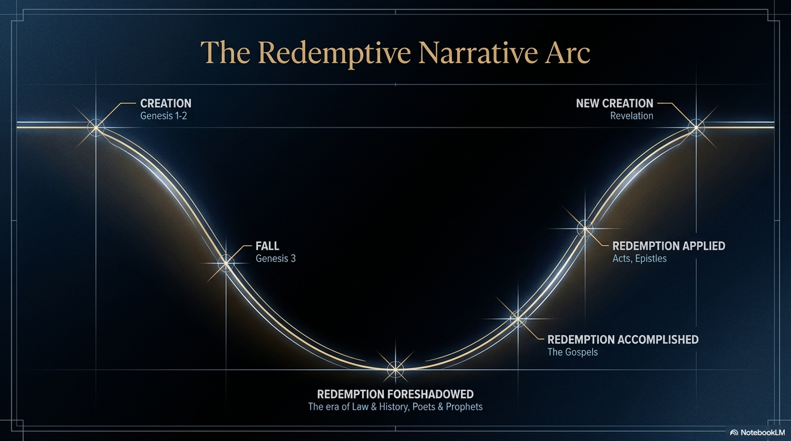

Slide 43
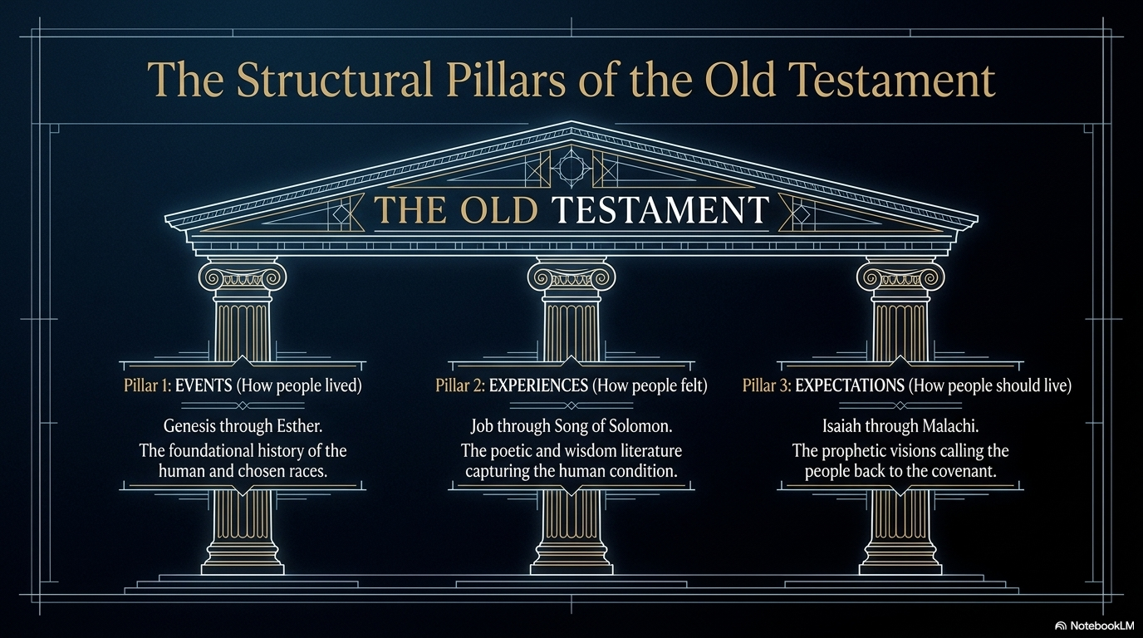

Slide 44
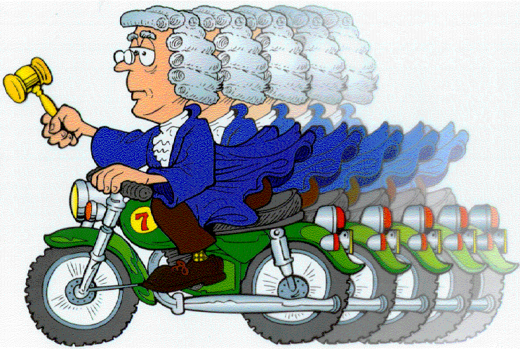
Abraham
Judges
Moses
Joshua
Judges

Slide 45

ABRAHAMIC
Gen 12, 15, 17, 22
Palestinian
Deut 30
Davidic
2 Sam 7
New
Jer 31
Land
Seed
Blessing

Slide 46
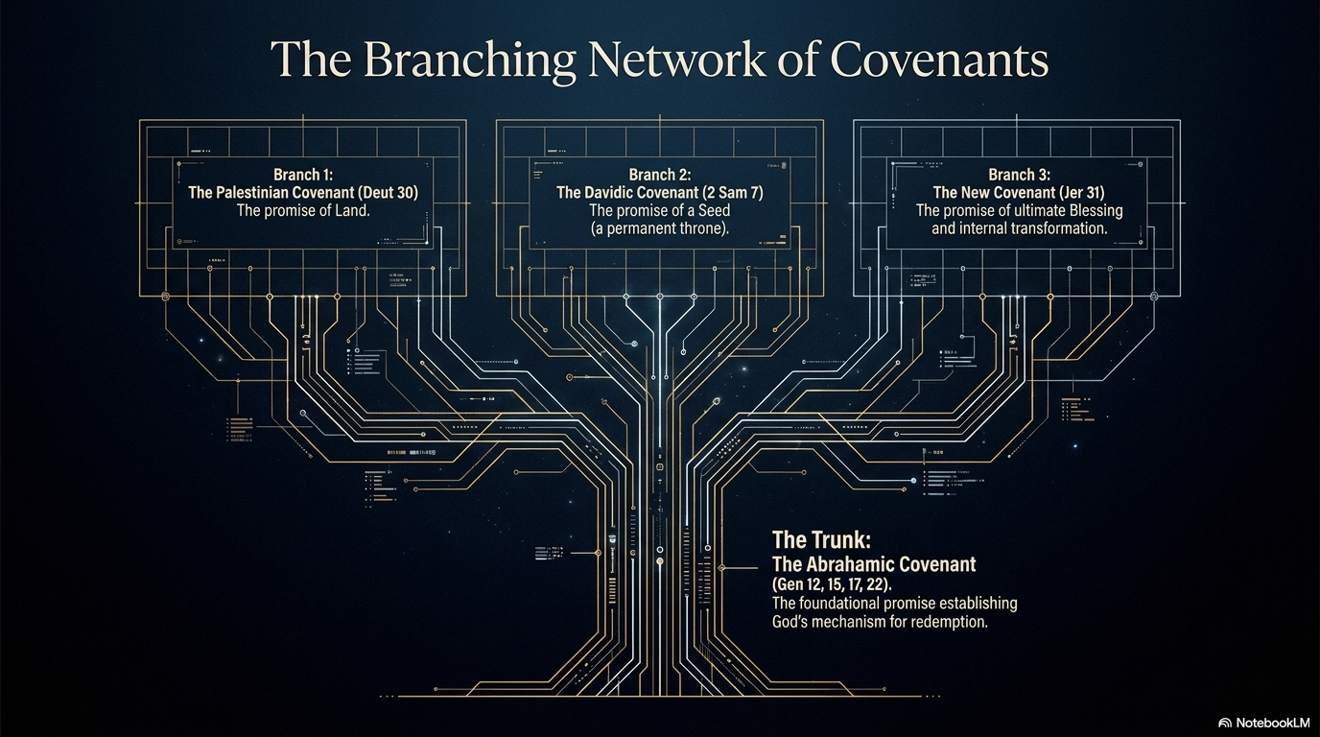

Slide 47

United
Divided
SURVIVING
N
I
19
0
A
S
D
S
B
S
J
20
8

Slide 48
United
Divided
SURVIVING
N
I
19
0
A
Returning
S
D
S
EXILED
B
S
J
20
8
70

Slide 49
U
D
S
E
R
70
400

